Slide 1
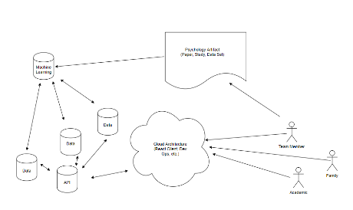
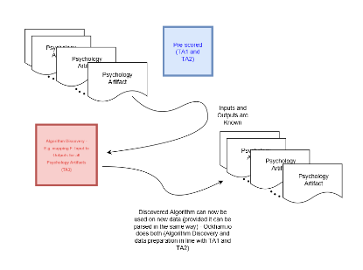
TA 3: Ockham.io Adam In Tae Gerard (POC) – Teaming is TBD
Ockham.io is proposed as an open-source, web-platform, to automate in whole or part the algorithmic
verification of scientific theories, hypotheses, and/or studies within the social and behavioral sciences per TA3 –
DARPA-SN-17-57.
Ockham.io entails three main components: (1) an React.js client to display and interact with data, (2) a set of
API’s to transmit data, and (3) a Machine Learning service to process social sciences artifacts. The Machine
Learning service will leverage powerful algebraic structures and natural language processing in Algorithm
Discovery (essentially using pre-scored sets of data from TA1 and TA2 to train Machine Learning networks for
new data).
Briefly, the approach taken involves: (1) explicitly formalizing embedded algebraic structures for computer verification; (2) soft verification through corroborating reputability of researchers, institutions, journals, and citations; (3) natural language processing to identify key terms, experimental variables, and concepts under study; (4) verifying sound experimental design and checking for logical consistency, numeric error, bias, and mathematical rigor; and (5) identifying how well the results, hypotheses, data, or conclusions cohere or are compatible with other high-credence theories.
Thus, the two novel approaches involve: applying compact algebraic structures identified by Patrick Suppes for computer verification (1) to vastly improve consistency checking (4), as well as overlaying many kinds of metadata filters (potentially combining proposed solutions, enhancing extensibility, and expanding the overall scoring data set).
The second approach provides greater opportunities to refine the datasets and algorithms used and is interesting in its own right (provides scientific data on scientific activities).
Ockham.io is proposed as an open-source, web-platform, to automate in whole or part the algorithmic verification of scientific theories, hypotheses, and/or studies within the social and behavioral sciences per TA3 - DARPA-SN-17-57.
Ockham.io’s web API’s will assist other teams and members to distribute and access information. It can, perhaps, become a viable service in its own-right essentially using paid subscriptions to continue the SCORE project indefinitely. In this second, commercial capacity, academic and scientific research could be scored greatly simplifying the difficulty in families seeking correct medical information, students researching for graduate papers, and public-policy makers to discern which data is accurate.
Ockham.io’s algorithm and Machine Learning service will be open-sourced to assist other teams and to incorporate recommended improvements. Bug bounties can be adopted to encourage open-source participation and the support of the wider academic and software communities.
A few known proposals to solve narrower and more focused problems include:
Prediction Markets can partly approximate reproducibility of scientific results – there are several limitations to this approach not least of which is that reproducibility of results is tied to a traded option (Wired Magazine).
Machine Learning and network graphs – tracking citation counts and previous winners of Nobel Prize Laureates can produce highly accurate predictions. The approach synthesizes what’s already known in terms of paper citations but clarifies such knowledge into formal graph networks (Nautil.us Magazine).
Using Schelling (Focal) Points to help coordinate information poor, secretive, or asymmetric credibility markets. An information and signaling theory concept that has begun to see application to a variety of scenarios (Kleros.io).
The three approaches above are not mutually exclusive with the primary innovation found in Ockham.io (explicitly formalizing embedded algebraic structures for computer verification). They can be overlaid onto the other filters and incorporated to refine, refute, or improve iterations or stages of Algorithm Discovery.
Source Selection Information – see FAR 2.101 & 3.104

